Slide 1
Python Machine Learning In Biology:
Unsupervised Learning Tour
Nichole Bennett

Slide 2
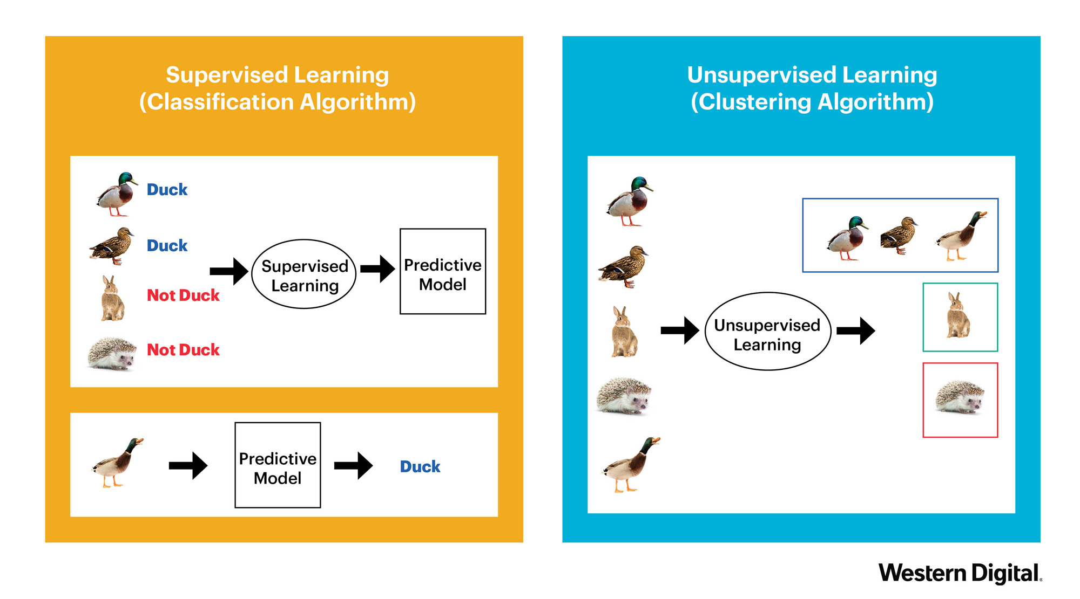
Supervised vs. Unsupervised Learning
Supervised --> Data has labels
Unsupervised --> Data doesn’t have labels

Slide 3
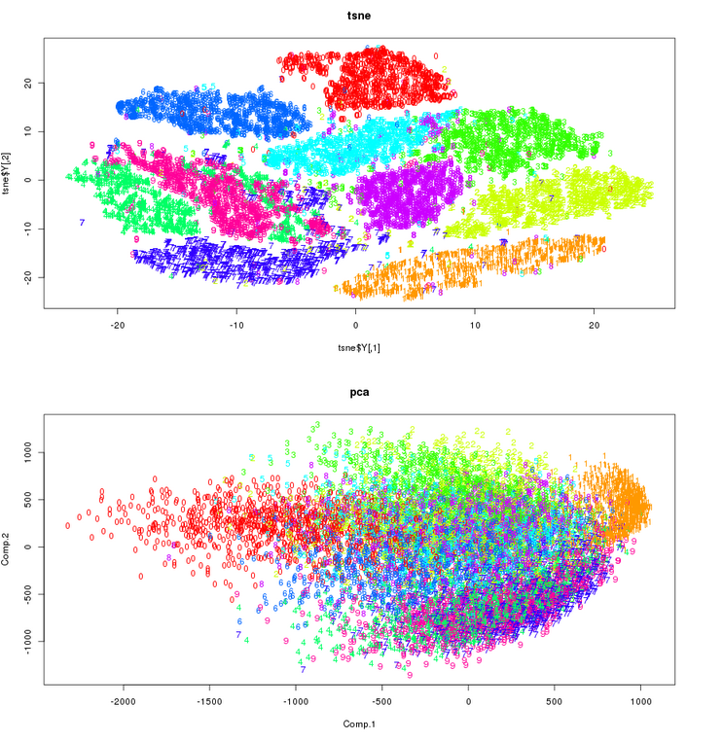
Unsupervised Learning
The goal is to find interesting structure or information in our data.
Applications:
Visualize the structure of complex data
Density estimates to predict probabilities of events
Compress and summarize data
Extract features for supervised learning tasks
Discover important clusters or outliers

Slide 4
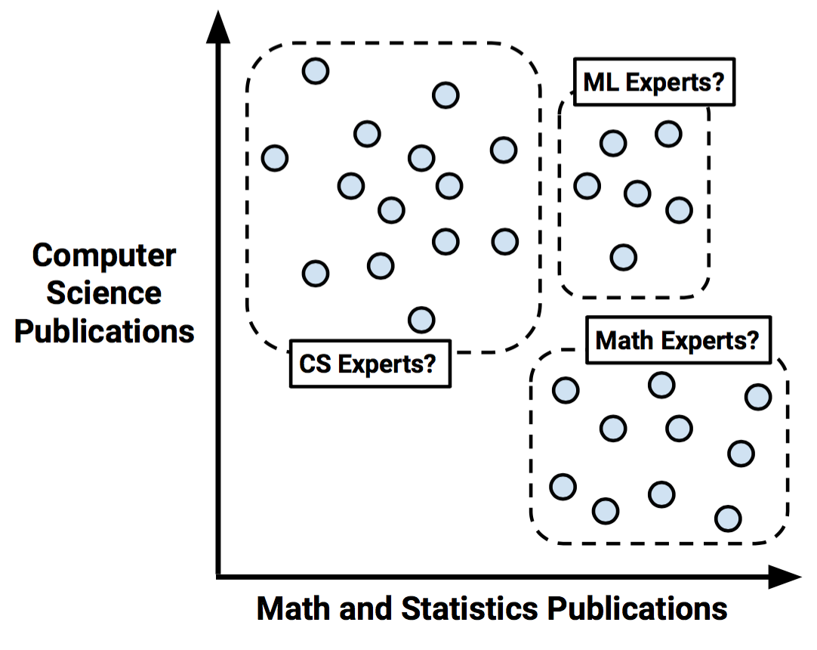
Two Main Types of Unsupervised Learning
Transformations
Processes that extract or compose information
Clustering
Find groups in data
Assign data points to groups

Slide 5
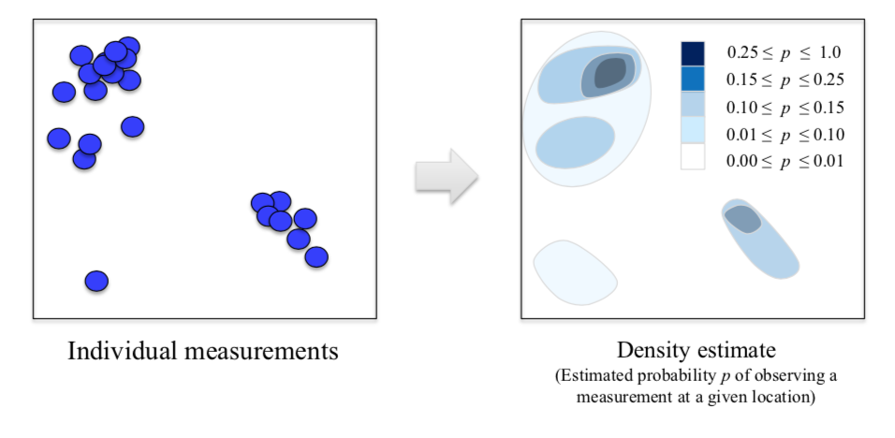
Transformation: Density Estimation Visualization
Have a set of measurements scattered throughout an area, want to create a smooth version that gives a general estimate for how likely it would be to observe a particular measurement in some area of space

Slide 6
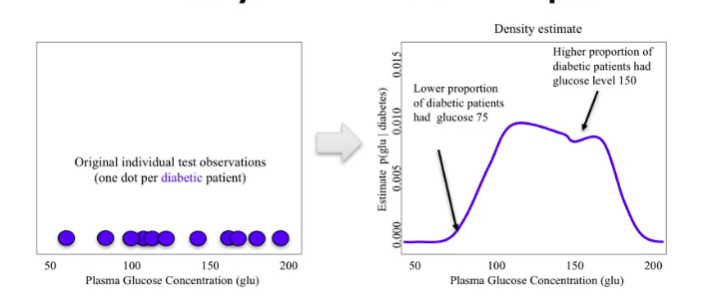
Density Estimation Example

Slide 7
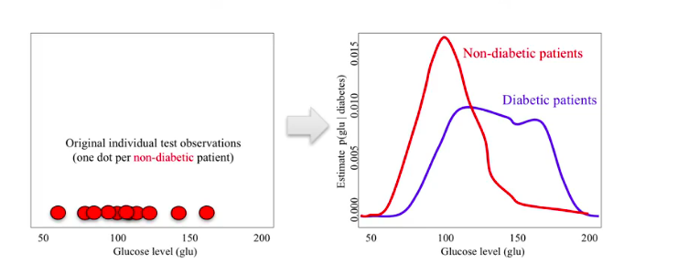
Density Estimation Example

Slide 8
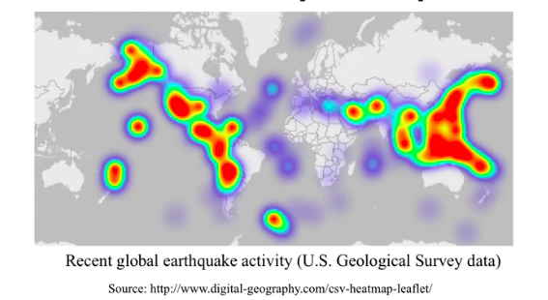
Density Estimation
Can be used to provide features for classification or regression
Calculates a continuous probability density over the feature space, given a set of discrete samples in that feature space
Notes:
KDE are especially popular for producing geographic heatmaps

Slide 9
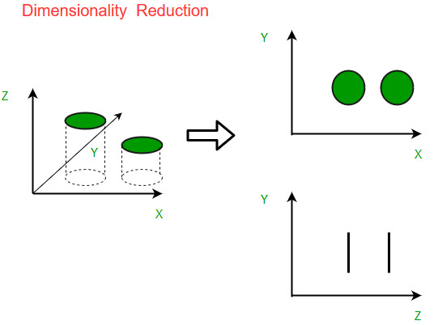
Transformation: Dimensionality Reduction
Find an approximate version of the dataset with less features
Used for exploring or visualizing a dataset to understand groupings or relationships
Often visualized as a 2-D scatterplot
Also used for compression and finding features for supervised learning

Slide 10
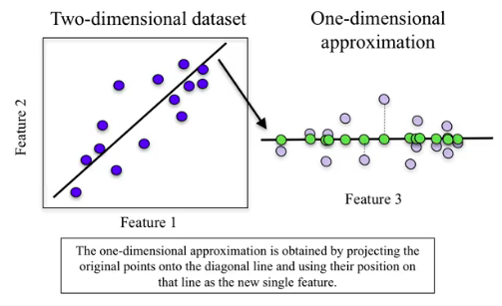
Dimensionality Reduction

Slide 11
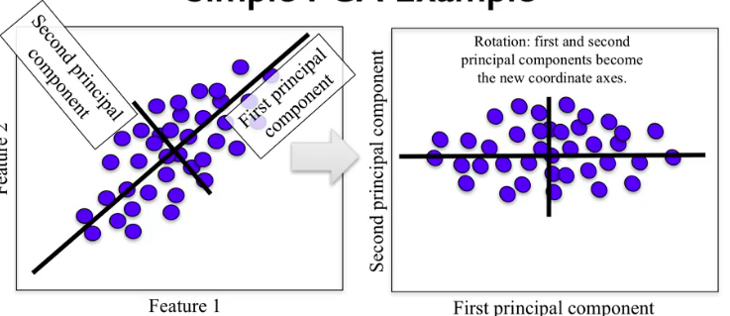
Principal Components Analysis
Notes:
Here, if we have two original features that are highly correlated represented by this cloud of points, PCA will rotate the data so the direction of highest variance - called the first principal component, which is along the long direction of the cloud, becomes the first dimension.
It will then find the direction at right angles that maximally captures the remaining variance.
This is the second principle component.
In two dimensions, there's only one possible such direction at right angles of the first principal component, but for higher dimensions, there would be infinitely many.
With more than two dimensions, the process of finding successive principal components at right angles to the previous ones would continue until the desired number of principal components is reached.
One result of applying PCA is that we now know the best one-dimensional approximation to the original two-dimensional data. In other words, we can take any data point that used two features before - x and y - and approximate it using just one feature, namely its location when projected onto the first principal component.

Slide 12
Principal Components Analysis
Take the cloud of original data and find the rotation of it so the dimensionals are statistically uncorrelated
Drops all but the most relevant information to capture most of the variation in the original dataset
With > 2-D, rinse and repeat until you have the number of desired principal components
PCA finds the best possible characteristics, that summarises the classes of a feature.
The most challenging part of PCA
is interpreting the components.

Slide 13
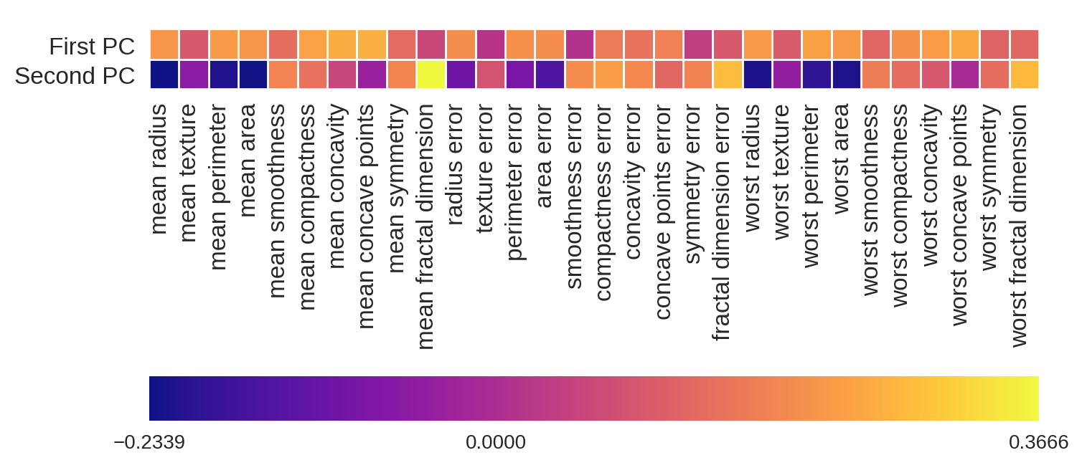
Principal Components Analysis
Notes:
We can also plot the feature magnitudes in the scatterplot like in R into two separate axes, also known as a biplot. This shows the relationship of each feature’s magnitude clearer in a 2D space.
Which components covary?

Slide 14
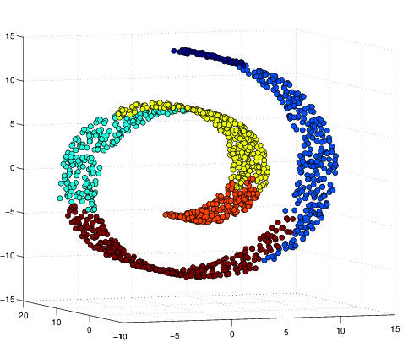
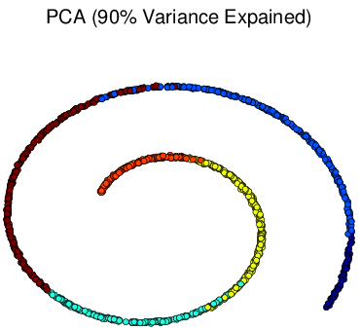
Manifold Learning Algorithms
PCA is a good initial tool, but it may not be able to find more subtle groupings that produce better visualizations for more complex data.
Manifold Learning Algorithms are a family of unsupervised learning algorithms that are good at finding low-dimensional structure in high-dimensional data and are useful for visualizations

Slide 15
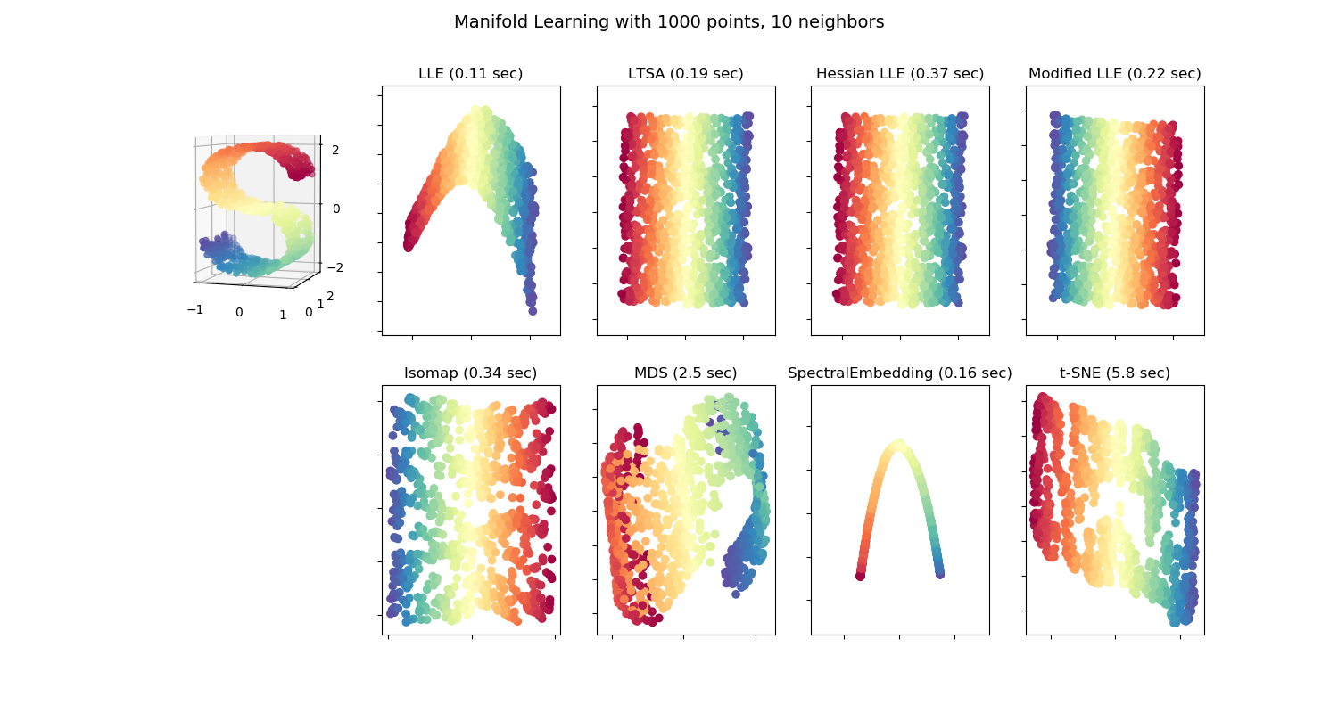

Slide 16
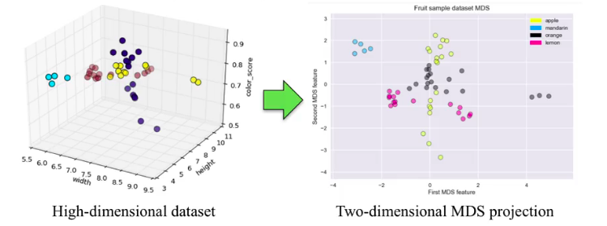
Multidimensional Scaling (MDS)
Visualize high-dimensional data and project it onto a lower-dimension
Preserves distance information

Slide 17
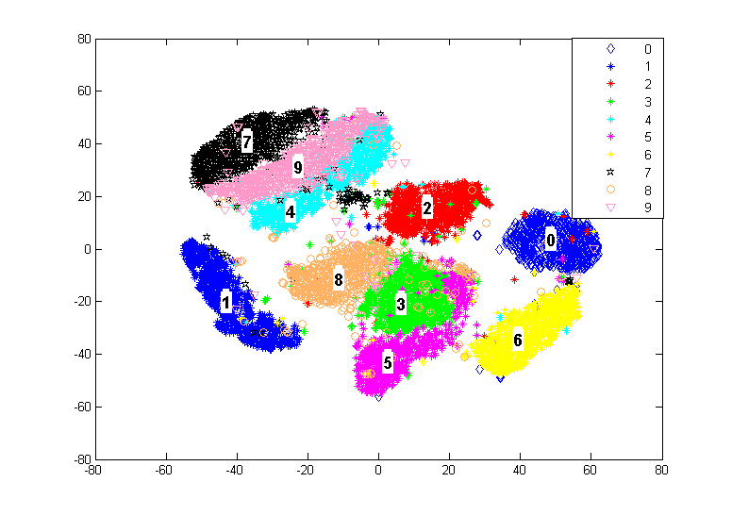
t-Distributed Stochastic Neighbor Embedding (t-SNE)
Powerful manifold learning method
Finds the 2-D representation by projecting and preserves neighbor distance information
Works better on data with more well-defined local structure
https://distill.pub/2016/misread-tsne/#citation

Slide 18
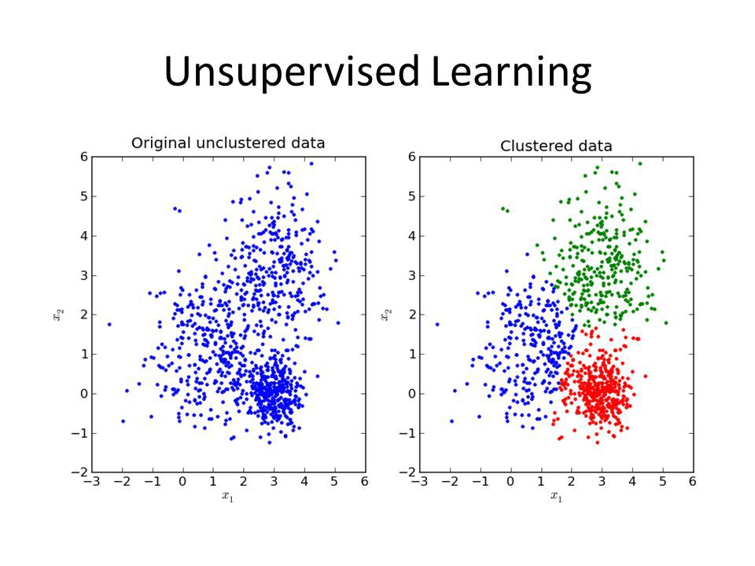
Clustering
Data points in the same cluster are ‘close’ or ‘similar’ in some way
Different clusters should be ‘far apart’ or ‘different
(important to scale data)

Slide 19
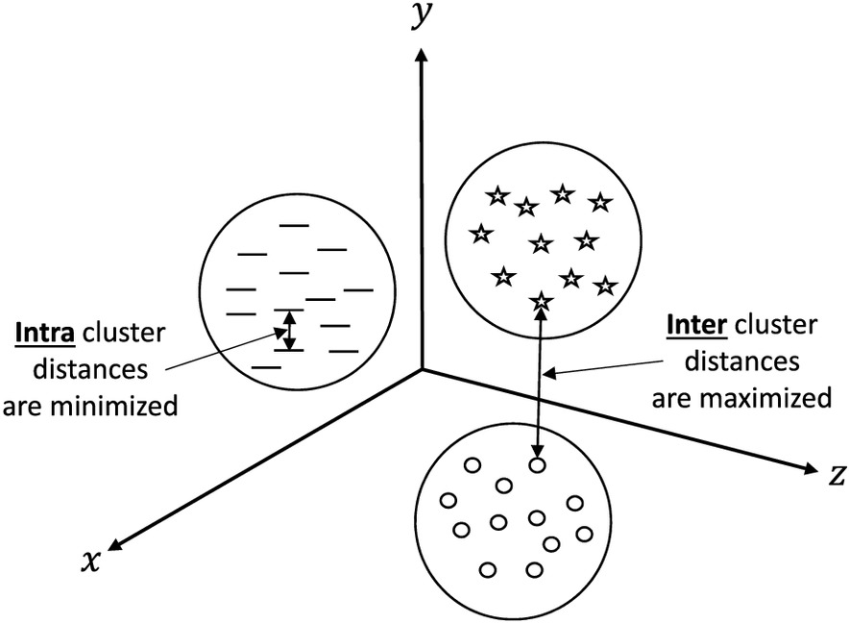
Clustering
The goal is to minimize intra-cluster distance and maximize inter-cluster distance

Slide 20
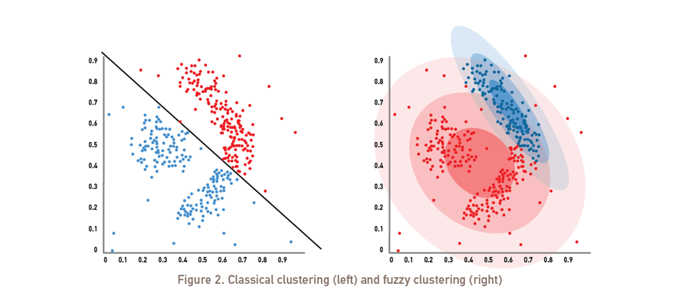
Hard vs. soft clustering algorithms
Hard clustering: each sample assigned to exactly one cluster
Soft clustering (aka fuzzy clustering): each sample assigned to one or more cluster, and cluster membership expressed as a probability

Slide 21
Clustering Methods
K-Means (mean centroids)
Hierarchical (nested clusters by merging or splitting successively)
DBSCAN (density based)
Affinity Propagation (graph based approach to let points 'vote' on their preferred 'exemplar')
Mean Shift (can find number of clusters)
Spectral Clustering
Agglomerative Clustering (suite of algorithms all based on applying the same criteria/characteristics of one cluster to others)

Slide 22
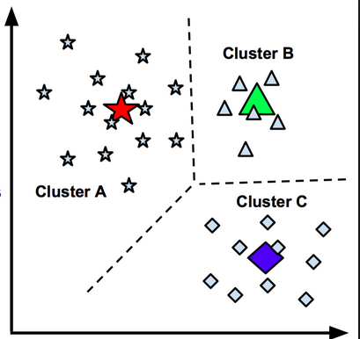
K-Means Clustering
Popular clustering algorithm
K is the number of clusters (chosen in advance)
Means refers to the mean points of the K clusters (known as centroids)
Goal is to partition the data into set such that the total sum of squared distances from each point to the mean point of the cluster is minimized.

Slide 23
K-Means Living Demo

Slide 24
K-mean algorithm
Pick a value for k (the number of clusters to create)
Initialize k 'centroids' (starting points) in your data
Create your clusters. Assign each point to the nearest centroid.
Make your clusters better. Move each centroid to the center of its cluster.
Repeat steps 3-4 until your centroids converge.
Unfortunately there is no formula to determine the absolute best number of k clusters. Unsupervised learning is inherently subjective! We can, however, choose the "best" k based on predetermined criteria.

Slide 25
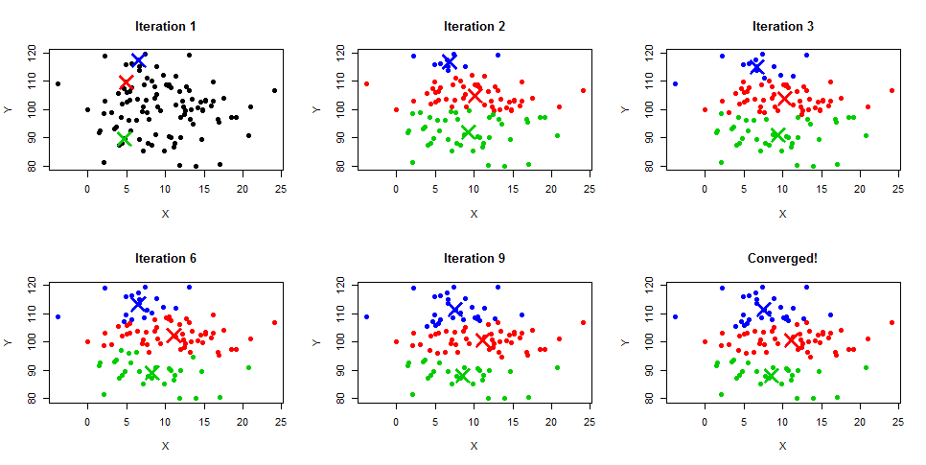

Slide 26
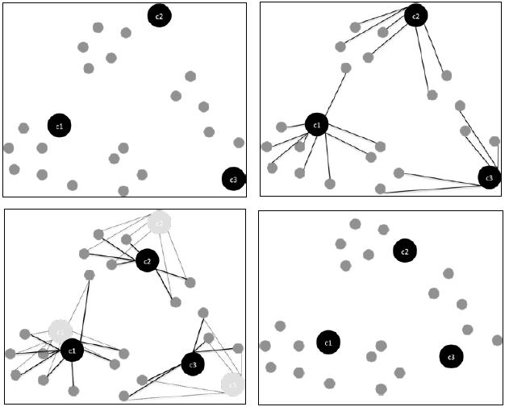

Slide 27
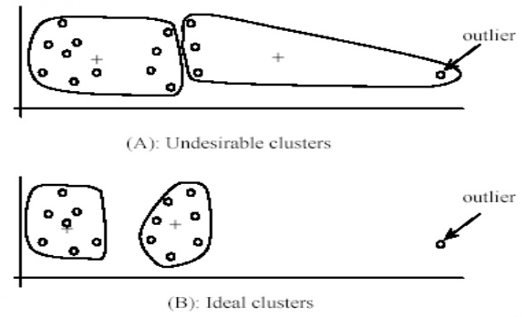
K-means is sensitive to outliers

Slide 28
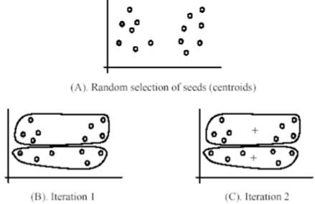
K-means is sensitive to centroid initialization

Slide 29
Initializing Centroids
Randomly
Manually
Special KMeans++ method in Sklearn (This initializes the centroids to be generally distant from each other)
Depending on your problem, you may find some of these are better than others.
Note: Manual is recommended if you know your data well enough to see the clusters without much help, but rarely used in practice.

Slide 30
K-means pros and cons
Advantages
K-Means is popular because it's simple and computationally efficient.
Easy to see results / intuitive.
Disadvantages
However, K-Means is highly scale dependent and isn't suitable for data of varying shapes and densities.
Evaluating results is more subjective, requiring much more human evaluation than trusted metrics.
Have to specify k.

Slide 31
K-means problems
Different solutions can converge with random initialization
Not everything can be reflected as a "glob" of points
Irregular shapes
Different densities
Inconsistent cluster spacing
Interpretation of results difficult without subject matter expertise
Accuracy is highly subjective
No formula for the correct number of clusters

Slide 32
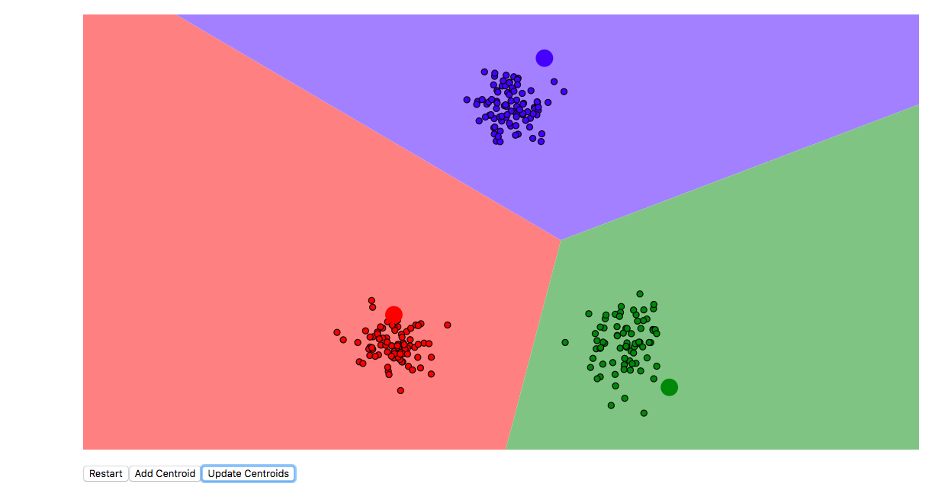
Visualizing k-means
https://www.naftaliharris.com/blog/visualizing-k-means-clustering/

Slide 33
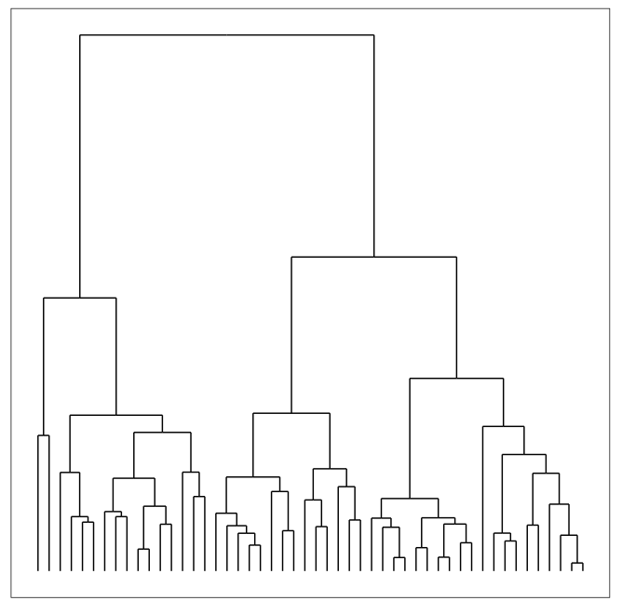
Hierarchical Clustering
Build hierarchies of clusters.
Connect the clusters in the hierarchy with links.
Once the links are determined, we can display them in what is called a dendrogram - a graph that displays all of these links in their hierarchical structure.

Slide 34
When does hierarchical clustering perform well?
Hierarchical clustering works well for non-spherical clusters
It also works well on smaller datasets - this algorithm has a longer computational time and doesn't work well for larger datasets
Hierarchical clustering works well for instances where we are working with frequencies.

Slide 35
Hierarchical Clustering vs. k-means
Both are unsupervised learning algorithms to divide data into groups.
In k-Means you decide what k is, and the algorithm finds the clusters by moving the centroids until none of the points change class.
In hierarchical clustering, the algorithm builds classification trees using the data that merge groups of similar data points. You don’t have to define “k.”
In k-Means, the boundaries between the various clusters are distinct and independent , whereas in hierarchical clustering there are shared similarities between those groups represented by the classification tree.

Slide 36
How Hierarchical Clustering Works
There are two forms of hierarchical clustering; agglomerative hierarchical clustering and divisive hierarchical clustering.
Agglomerative goes from the bottom-up, starting with single data points and merging them into groups.
Divisive goes from the top down, starting with all the data points and dividing them.
Whether starting from the top or bottom, at each step the algorithm makes the best choice it can to join or split the data based on the current sample.

Slide 37
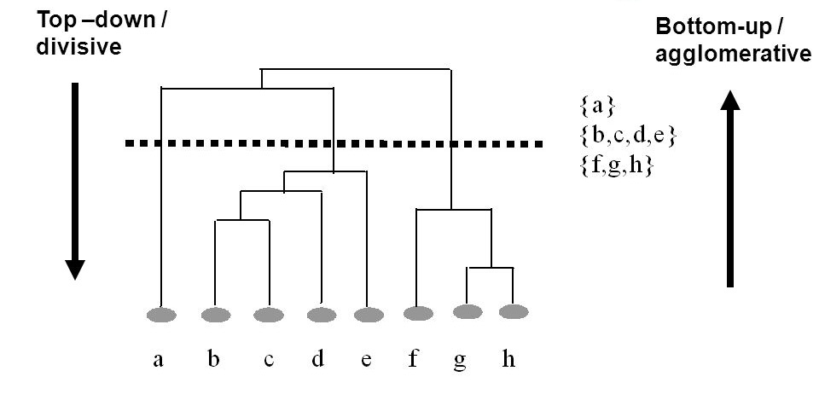

Slide 38
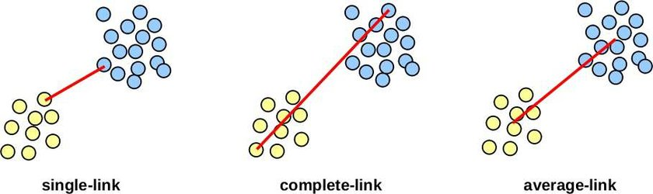
Algglomerative Clustering
Single linkage: compute the distances between the most similar members for each pair of clusters and merge the two clusters with the smallest distance
Complete linkage: same but compare most dissimilar members.
Ward: least increase in total variance of centroids of cluster (this is usually the one we pick)

Slide 39
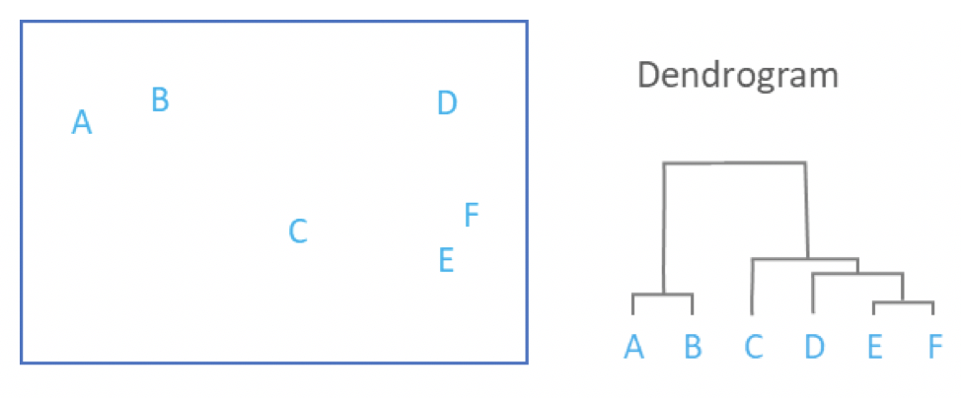
Notes:
Dendrogram also helps us pick how many clusters we want to use. If there are distances that are really far apart vs highly similar clusters (look at A and B versus all the rest), this indicates it may be a good cutoff for cluster number.

Slide 40
DBSCAN
Density-Based Spatial Clustering of Applications with Noise
Clusters of high density are separated by clusters of low density
The number of points that lie in a radius ε. You choose ε as well as the minimum number of points it takes to make a cluster.
RULES OF THUMB: choosing the minimum points - you should always aim to have the minimum number of points be greater or equal to the amount of dimensions in your data, plus one. This typically will give the algorithm a good estimation of how to evaluate the clusters. Calculating epsilon is a bit trickier and uses a method called the k-distance, which can help visualize the best epsilon.

Slide 41
DBSCAN Algorithm
1. Choose an “epsilon” and “min_samples”
2. Pick an arbitrary point, and check if there are at least “min_samples” points within distance “epsilon”
If yes, add those points to the cluster and check each of the new points
If no, choose another arbitrary point to start a new cluster
3. Stop once all points have been checked

Slide 42
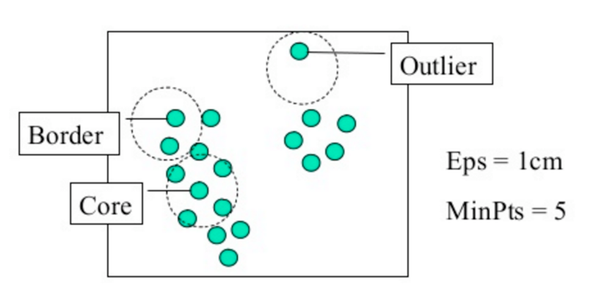
Notes:
Core point: at least the specified number of points fall in the specified radius epsilon
Border point: fewer than minpts neightbors within epsilon but falls within epsilon of a core point
Outlier: neither border nor core

Slide 43
Pros and Cons of DBSCAN
PRO: Doesn’t assume clusters have spherical shape and can handle noise
PRO: eps implicitly controls number of clusters
CON: Increasing number of features brings on curse of dimensionality
CON: Have to optimize two hyperparameters (can be difficult if density differences are large)
CON: If you don’t set the parameters well, everything gets labeled as noise (-1)

Slide 44
DBSCAN vs. k-means
k-means is a "general" clustering approach, DBSCAN performs especially well with unevenly distributed, non-linear clusters.
DBSCAN is density based, which means that it determines clusters based on the number of points in a certain area
By choosing too few points for DBSCAN, i.e. less than two, we'll effectively get a straight line if we connect the points, just like linkage clustering.

Slide 45
DBSCAN vs. hierarchical clustering
DBSCAN can be useful to us when we have a lot of dense data. IADVANTAGES –
Clusters can be any size or shape
No need to choose number of clusters
BUT
More parameters to tune
Doesn’t work with clusters of varying density
NOTE: Not every point is assigned to a cluster!

Slide 46
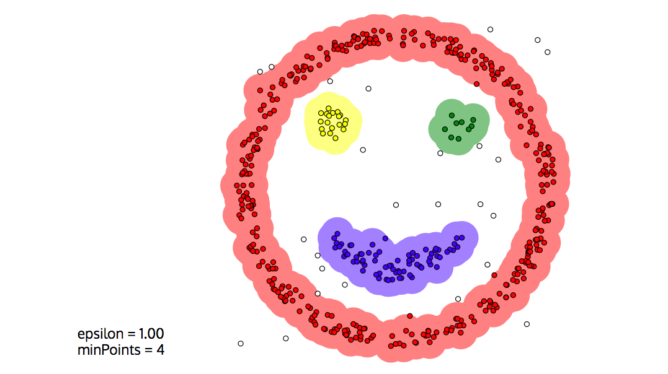
Visualizing DBSCAN
https://www.naftaliharris.com/blog/visualizing-dbscan-clustering/

Slide 47
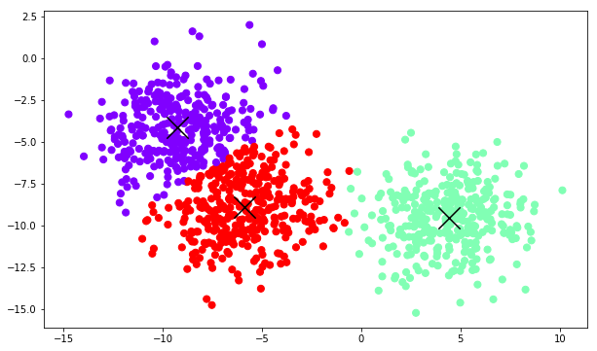
Best way to evaluate clusters?
Visually examine them!
(If you can)

Slide 48
Evaluating Clusters
Less automatic than supervised learning because we don’t have ground truth
Multiple clusterings may be possible
Task-based evaluation → performance of tasks that has an objective basis for comparison (e.g. gene families)
effectiveness of clustering-based features for a supervised learning
tasks--overall accuracy gain from adding a feature
Some evaluation metrics exist, but they can be unreliable
How do we interpret the meanings of label clusters? Need human expertise

Slide 49
Metrics
Inertia -- sum of squared errors for each cluster
Low inertia = dense cluster
Internal coherence
Silhouette Coefficient -- measure of how far apart clusters are
High Silhouette Score = clusters are well separated
External coherence

Slide 50
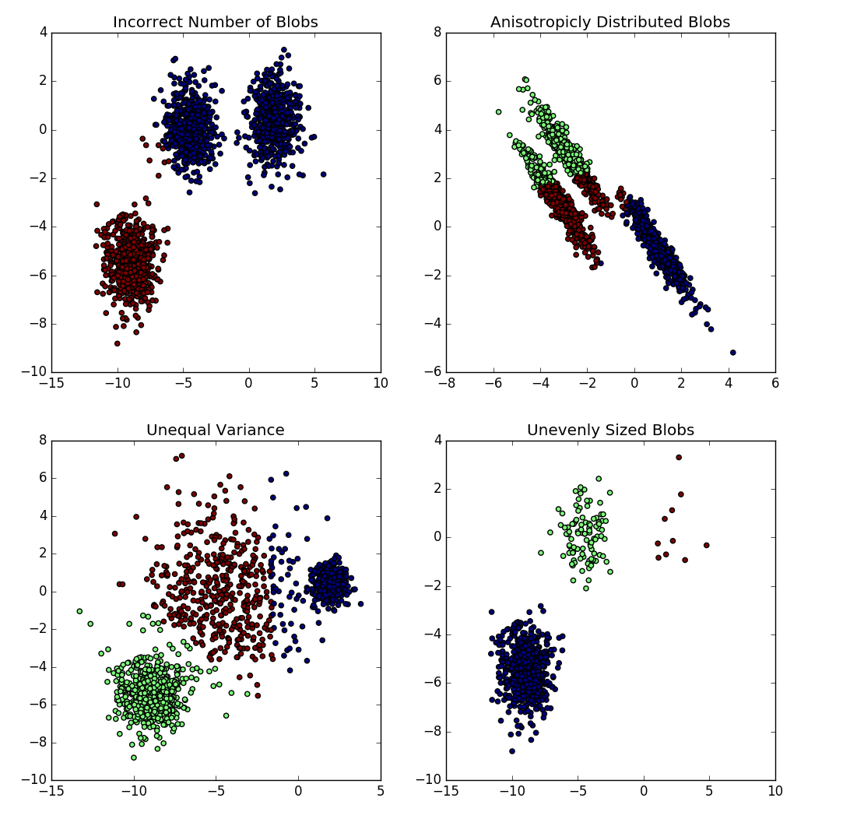
Problems with Inertia
Notes:
Fitting using Inertia makes the assumption that clusters are convex and isotropic, which is not always the case. It responds poorly to elongated clusters, or manifolds with irregular shapes.
Inertia is not a normalized metric: we just know that lower values are better and zero is optimal. In very high-dimensional spaces, Euclidean distances tend to become inflated (this is one instance of the so-called “curse of dimensionality”). Running a dimensionality reduction algorithm such as PCA prior to k-means clustering can alleviate this problem and speed up the computations.

Slide 51
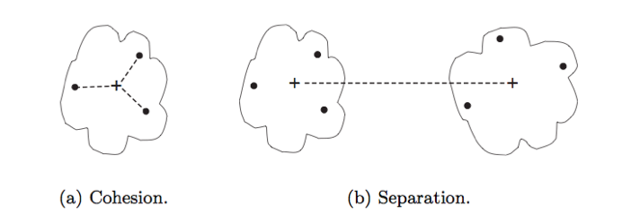
Silhouette Coefficient
Cohesion: measures clustering effectiveness within a cluster.
Separation: measures clustering effectiveness between clusters.

Slide 52
Silhouette Coefficient
The silhouette coefficient combines the cohesion and the separation into a single metric. The silhouette coefficient for a single observation is calculated:
a_{i}= mean intra-cluster distance of the sample to others within the cluster (cohesion)
b_{i} = the mean nearest-cluster distance from the sample to those within the nearest non-assigned cluster (separation)
The coefficient ranges from -1 to 1:
A score of 1 indicates the maximum cohesion and separation of clusters.
A score of -1 indicates the minimum cohesion and separation of clusters.

Slide 53
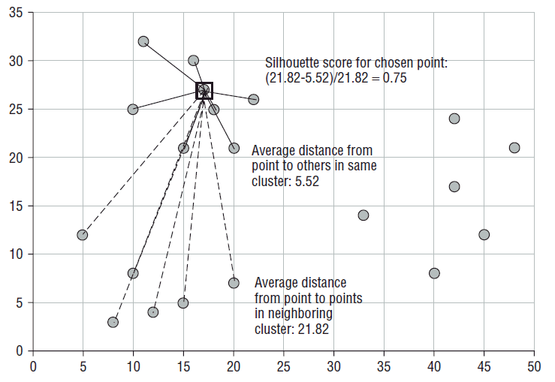

Slide 54
Interpreting the silhouette coefficient
When you calculate the silhouette score using sklearn you get out a single number. This is the average silhouette score for all of the individual observations.
In general, we want separation to be high and cohesion to be low. This corresponds to a value of SC close to +1.
A negative silhouette coefficient means the cluster radius is larger than the space between clusters, and thus clusters overlap. Another way to think about this is that negative values indicate that non-assigned clusters are more similar than the assigned cluster.

Slide 55
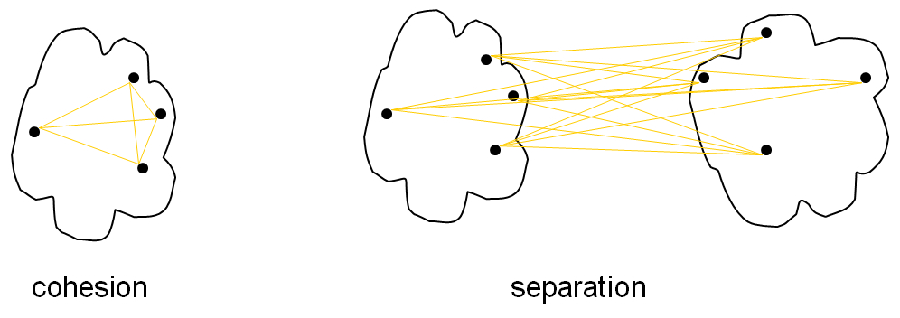
Silhouette plots
Evaluating how the silhouette changes different numbers of K can give you a rough sense of the quality for K clusters in terms in cohesion and separation.
Remember that we have a silhouette of 0 if cohesion = separation. Ideally, we want separation >> cohesion because we want that sample to be distinct and different to samples in other groups but really similar to samples in its group.

Slide 56
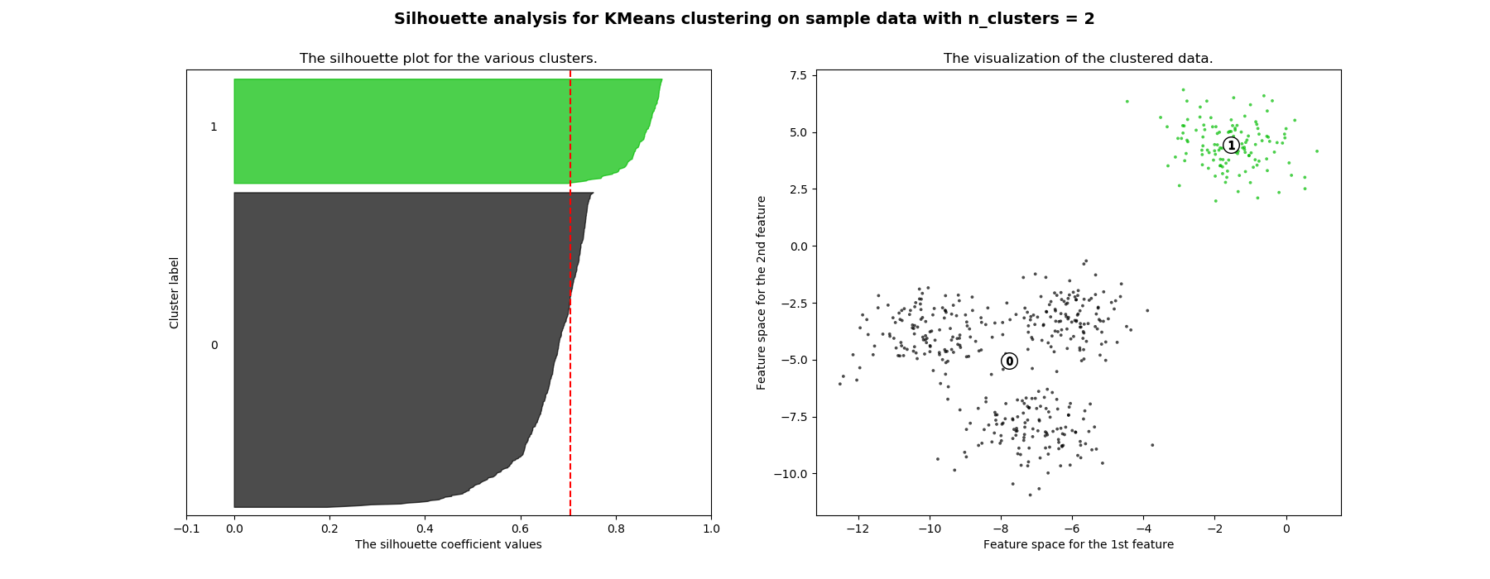
Interpreting Silhouette Plots (K = 2)

Slide 57
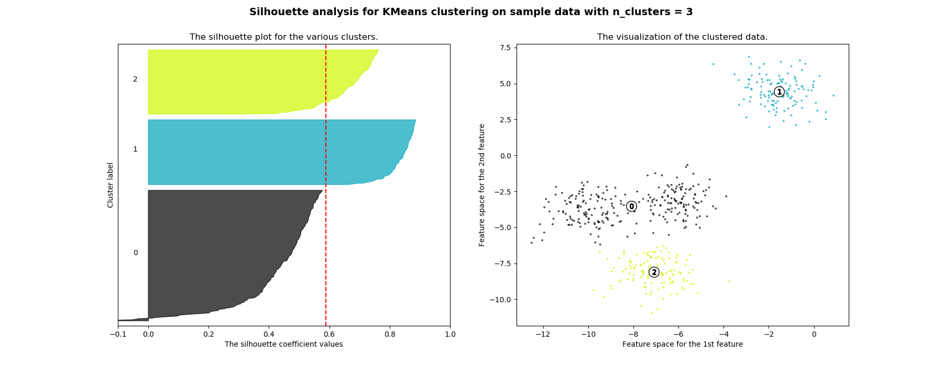
Interpreting Silhouette Plots (K=3)

Slide 58
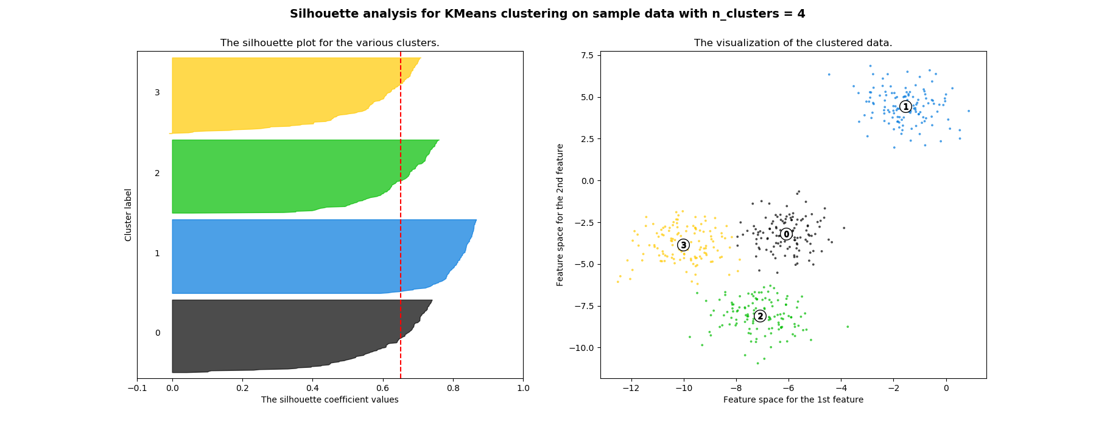
Interpreting Silhouette Plots (K=4)

Slide 59
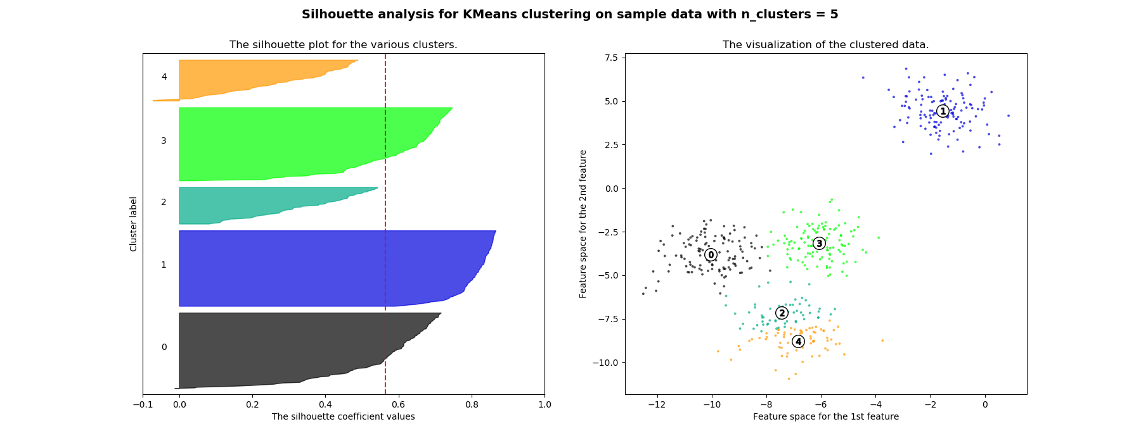
Interpreting Silhouette Plots (K=5)

Slide 60
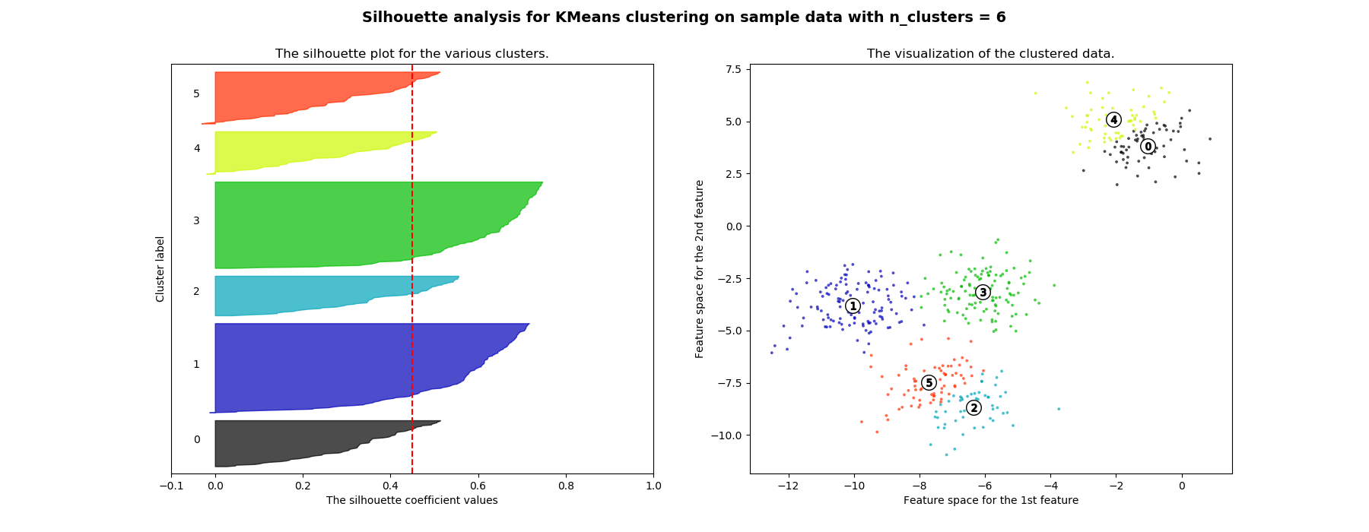
Interpreting Silhouette Plots (K=6)

Slide 61
Elbow Method (choosing K)
Plot inertia (aka distortion) vs. the K number of clusters to get an idea of what the optimal number of clusters would be for the dataset.
Elbow method: look for the K where the inertia has an "elbow": the point where decreases in inertia are considerably more marginal than for previous increases in K.

Slide 62
